Slide 1
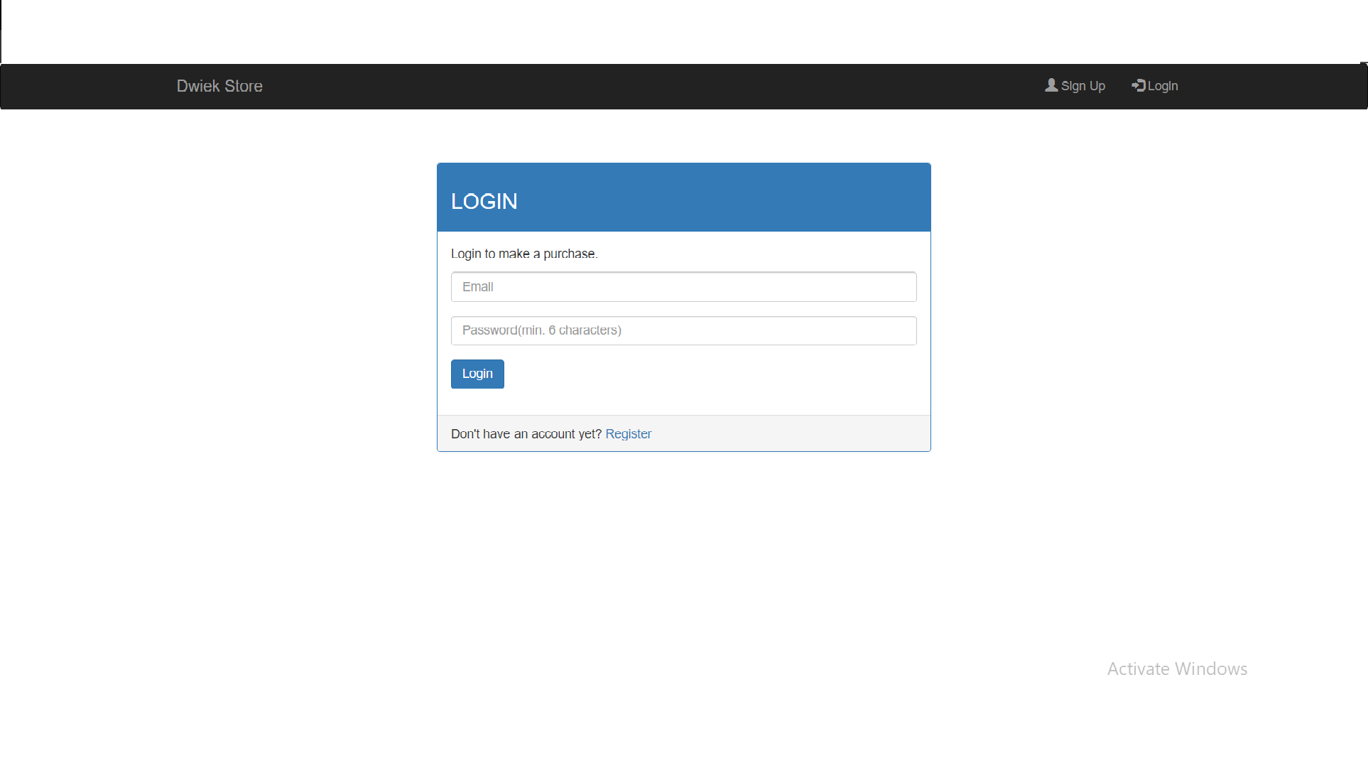
Dwiek Store
login signup mainpage cart setting
Insert your email and password
Register if u do not have an email

Slide 2
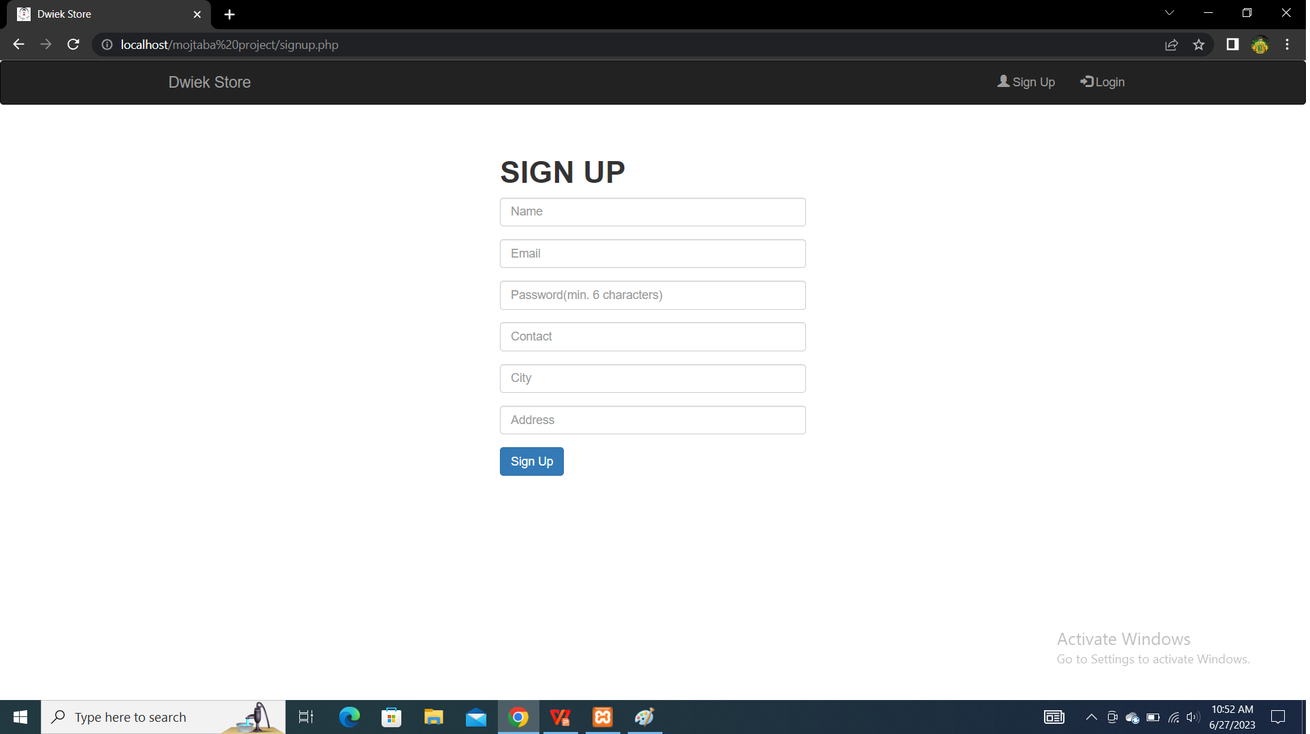
Dwiek Store
login signup mainpage cart setting
fill the signup form with the required details

Slide 3
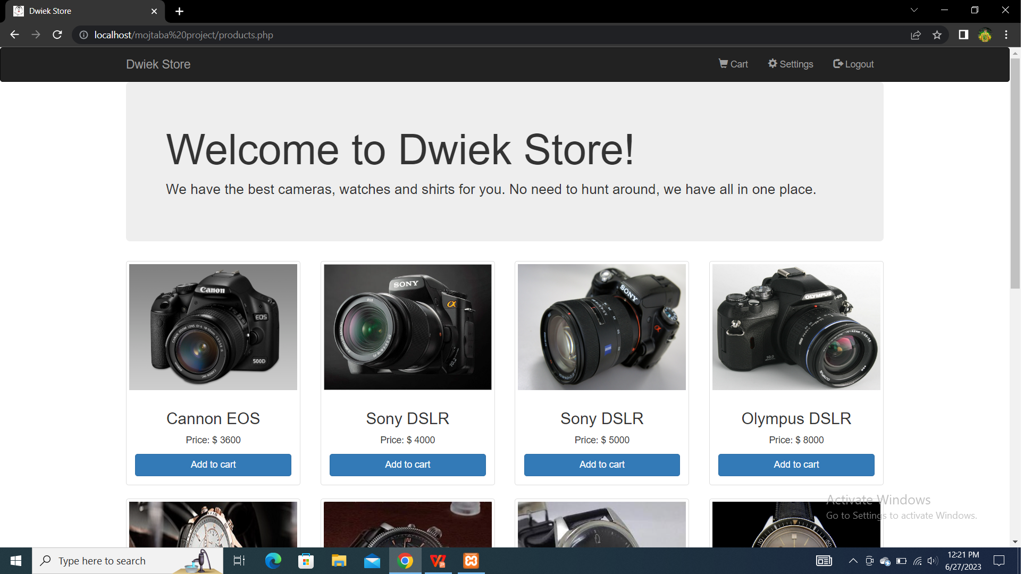
Dwiek Store
login signup mainpage cart setting
Add any item u desire by pressing add to cart.

Slide 4
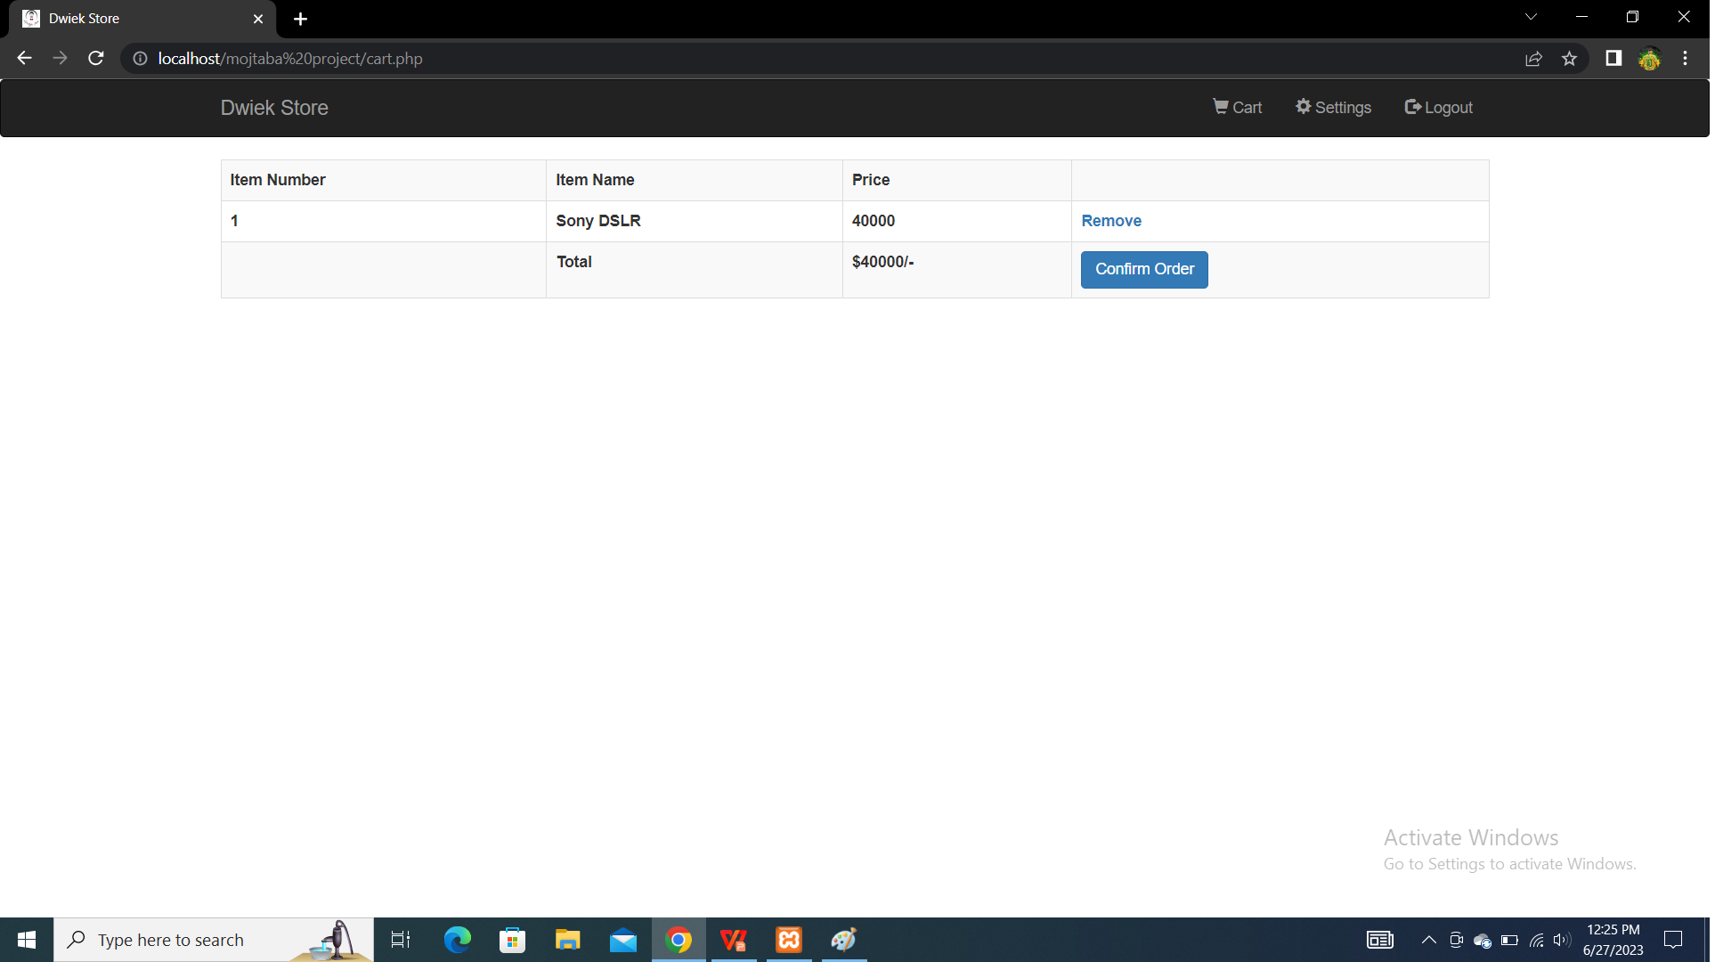
Dwiek Store
login signup mainpage cart setting
After adding items to your cart u press on cart and you will be transfered to checkout ,showing all the items u added.

Slide 5
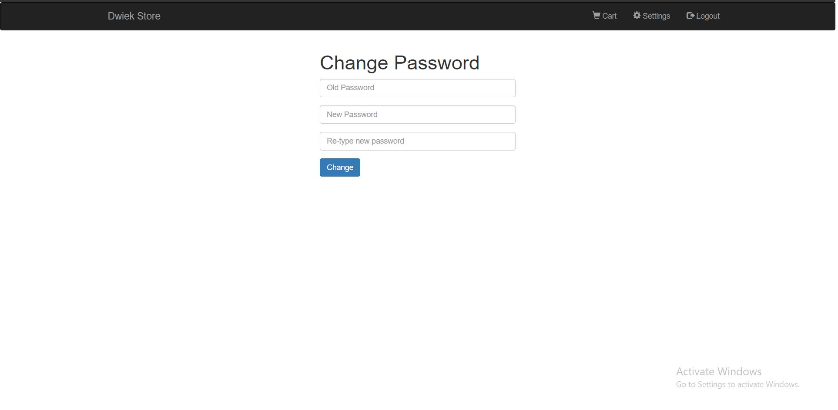
Dwiek Store
login signup mainpage cart setting
If u like to change ur password ,just press setting and u will be transfered to page where u can enter your new password, however u need to have the old one

